Slide 1
MARKETING ANALYTICS
SESSION 18
DIGITAL DISPLAY ADVERTISING
Texas MSBA Program
Professor Sonnier
Fall 2022

Slide 2
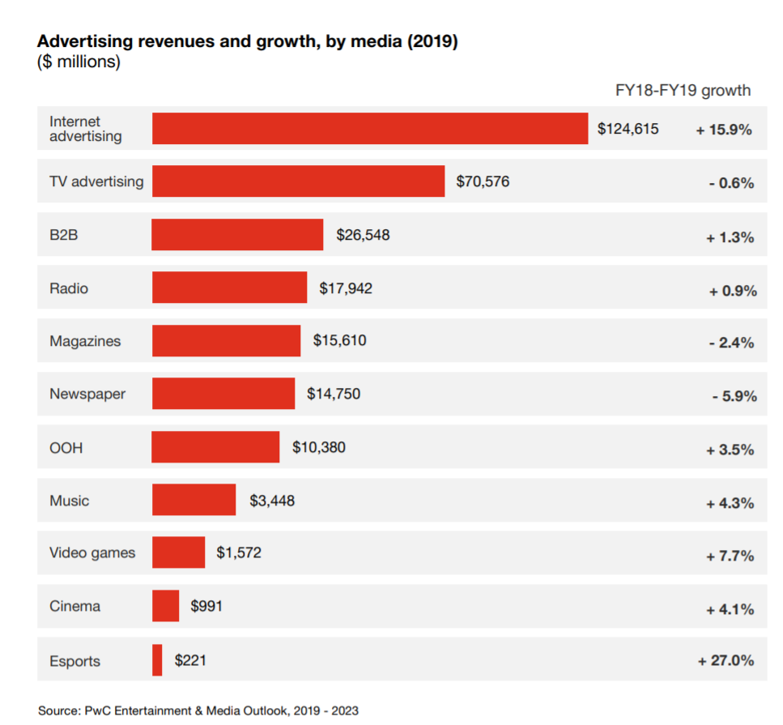
DIGITAL MARKETING
Format Shares Over Time (% of Revenues)
Source: IAB PwC Internet Ad Revenue Report 2016

Slide 3
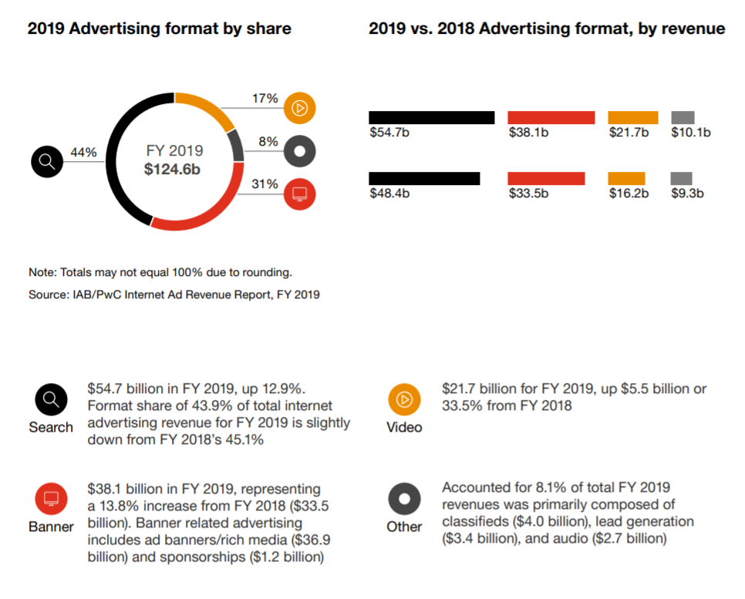
DIGITAL MARKETING
Digital Advertising is Mostly Search and Display

Slide 4
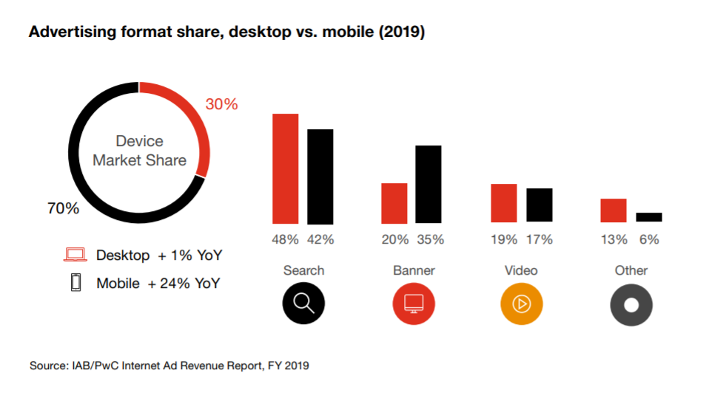
DIGITAL MARKETING
Desktop vs Mobile

Slide 5
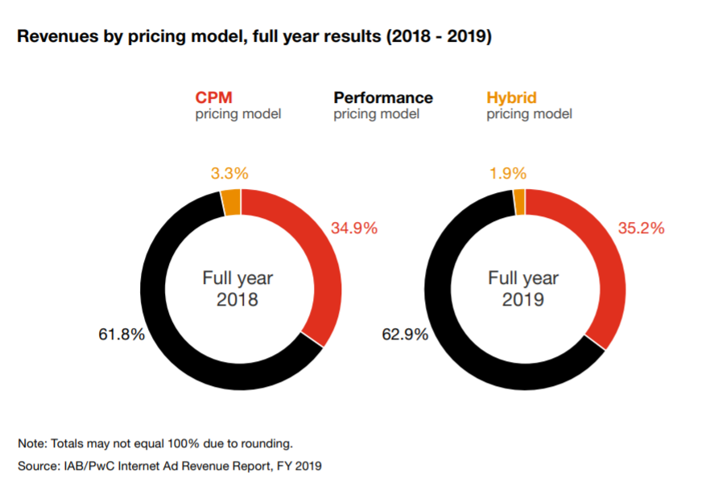
DIGITAL MARKETING
Digital Advertising Pricing Models

Slide 6


DIGITAL MARKETING
Digital Display Advertising

Slide 7
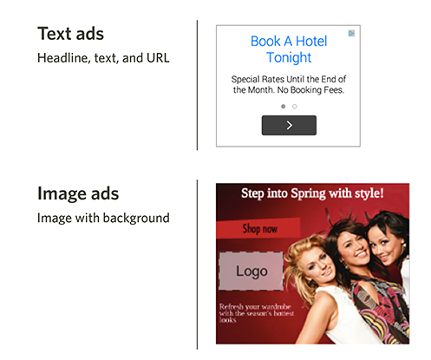
DIGITAL MARKETING
Types of Display Ads

Slide 8
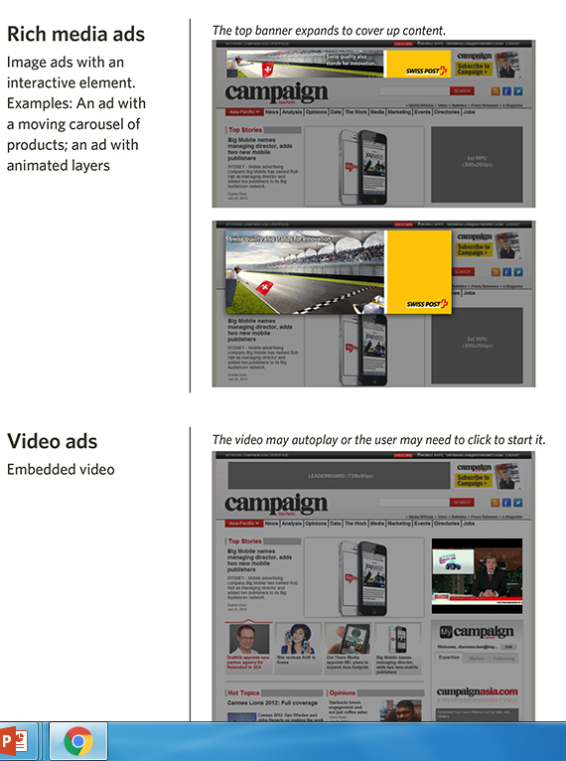
DIGITAL MARKETING
Types of Display Ads

Slide 9
A CONCERN WITH RESPONSE MODELS
Does Advertising Matter?
Does Advertising Matter? A Closer Look
The effect of a $ increase in sales on advertising
What if Toyota is setting their ad budget based on expected sales?
Cars that are expected to sell more are supported by higher advertising.
Causality is reversed! Sales drives advertising allocation

Slide 10



Channel Structure at Warby Parker: Showrooms
FIELD EXPERIMENTS

Slide 11

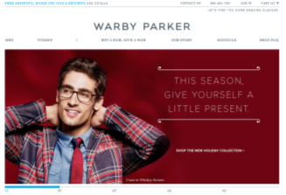





FIELD EXPERIMENTS
What Happened to Web and HTO Channels when Showrooms Opened?
Web Sales
Visit website
Decide on your glasses
Home Try On
Select any five pairs of glasses
They’ll ship them to you for free
You’ll have five days to try out the frames
Visit a Showroom
Locate one of the 20 Showrooms
Visit the Showroom

Slide 12
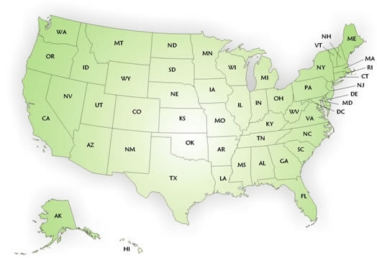

DIGITAL MARKETING AND FIELD EXPERIMENTS
Warby Parker Showrooms: Treatment and Control Groups
Treatment Group: Customers within a 30-mile radius of a showroom
Control Group: Customers outside a 30-mile radius of a showroom
What I really would love to do is set up showrooms then randomly assign consumers to live near or far
This is exactly what I can do in a Digital A/B Test

Slide 13


DIGITAL MARKETING
Is Digital Display Advertising Effective?
Set Up for a Digital Display A/B Test
Algorithm Makes Targeting Decision
Random Assignment
Treatment Condition
Serve an Ad to User
Control
Condition

Slide 15
DIGITAL MARKETING
Is Digital Display Advertising Effective?
Data
Campaign ran for ~three months
Over 14.5 million impressions served to nearly 590,000 users
We have a random sample of 50,000 of the users
Let’s begin by checking the count and percentage of users in the treatment and control groups
Test=1: Treatment Group (saw handbag ad)
Test=0: Control Group (saw PSA ad)

Slide 16
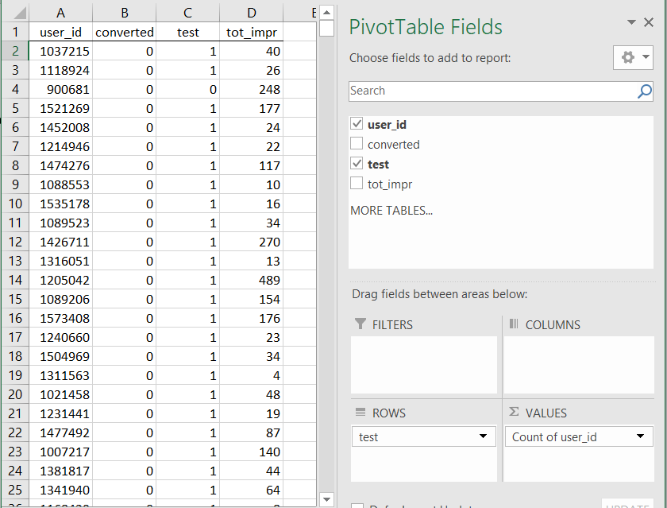
DIGITAL MARKETING
Digital Display Advertising Effectiveness
Check the number and % of respondents in the test and control conditions

Slide 17
DIGITAL MARKETING
Digital Display Advertising Effectiveness
Check the number and % of respondents in the test and control conditions

Slide 18
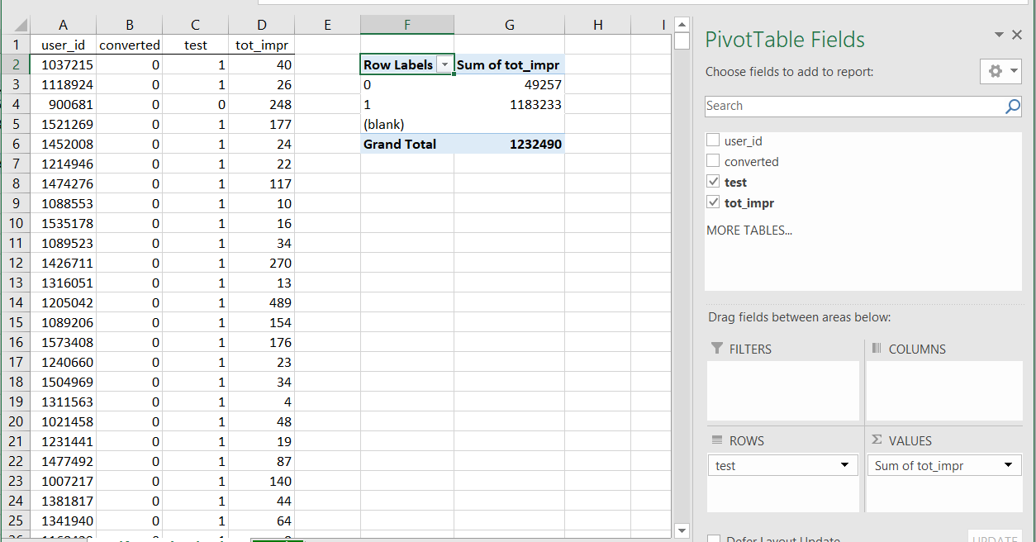
DIGITAL MARKETING
Digital Display Advertising Effectiveness
How to Verify Randomization?

Slide 19
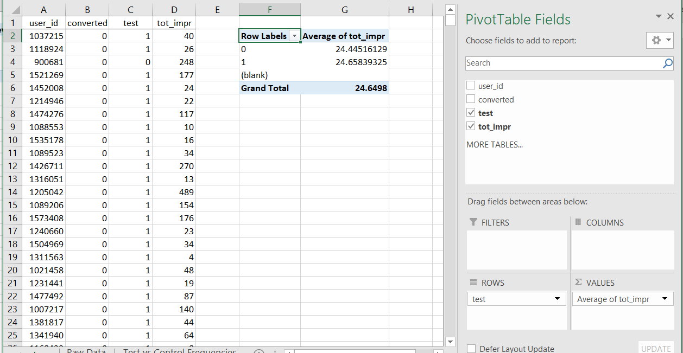
DIGITAL MARKETING
Digital Display Advertising Effectiveness
How to Verify Randomization?

Slide 20
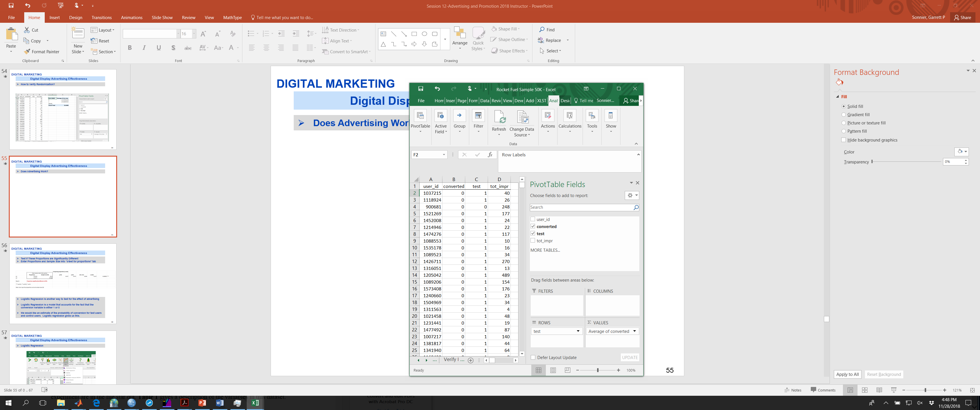
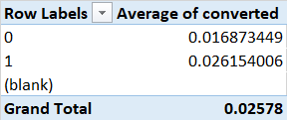
DIGITAL MARKETING
Digital Display Advertising Effectiveness
Does Advertising Work?

Slide 21
DIGITAL MARKETING
Digital Display Advertising Effectiveness
Test if These Proportions are Significantly Different
Enter Proportions and Sample Size into “z-test for proportions” tab
Logistic Regression is another way to test for the effect of advertising
Logistic Regression is a model that accounts for the fact that the conversion variable is either 1 or 0
We would like an estimate of the probability of conversion for test users and control users. Logistic regression gives us this.

Slide 22
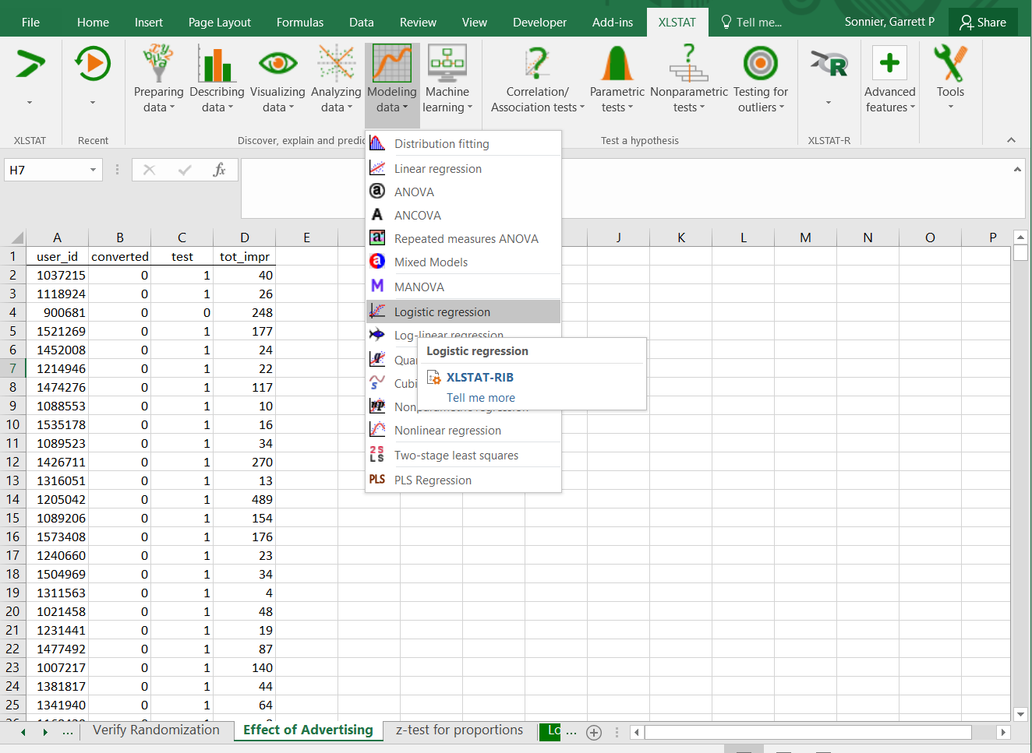
DIGITAL MARKETING
Digital Display Advertising Effectiveness
Logistic Regression

Slide 23
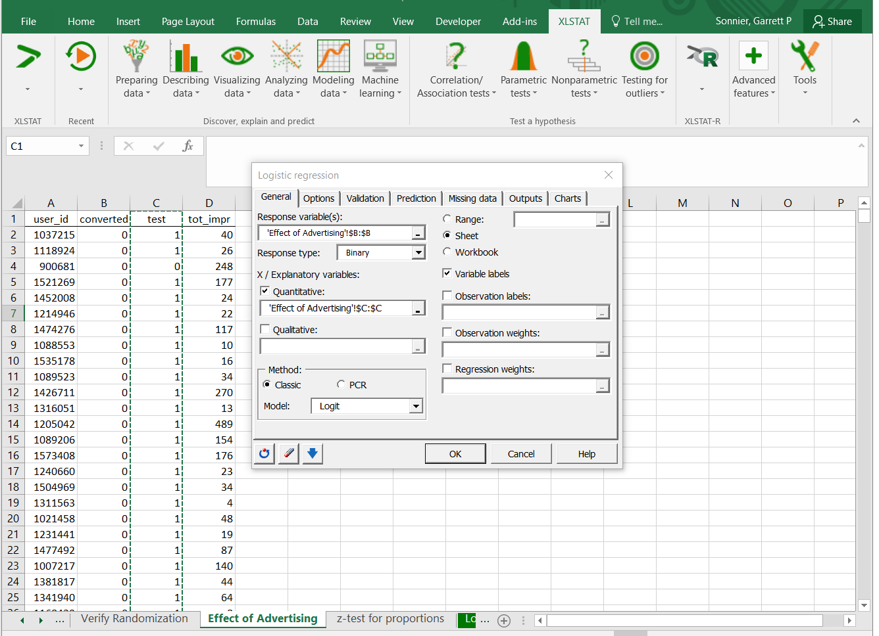
DIGITAL MARKETING
Digital Display Advertising Effectiveness
Logistic Regression
Y variable is Conversion (in Column B)
X variable is Test (in Column C)

Slide 24
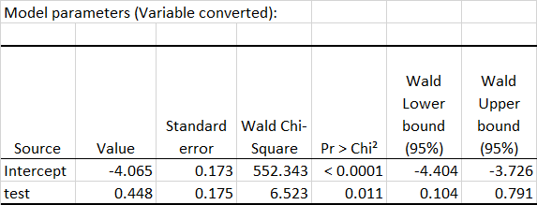
DIGITAL MARKETING
Digital Display Advertising Effectiveness
Logistic Regression
Y variable is Conversion (in Column B)
X variable is Test (in Column C)

Slide 25
DIGITAL MARKETING
Digital Display Advertising Effectiveness
It seems that advertising did increase the conversion rate
Evidence from z-test of proportions and logistic regression
But was the campaign profitable?
What was the gain in contribution?
What was the cost of the campaign?
What was the ROI?

Slide 26
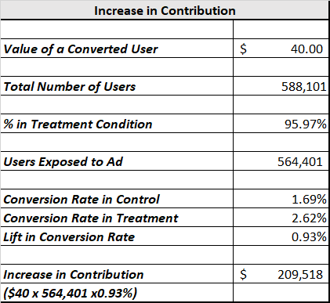
DIGITAL MARKETING
Digital Display Advertising Effectiveness
Increase in Contribution

Slide 27
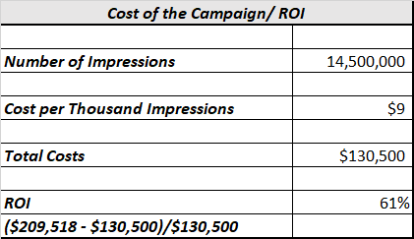
DIGITAL MARKETING
Digital Display Advertising Effectiveness
Cost/Return on Investment

Slide 28
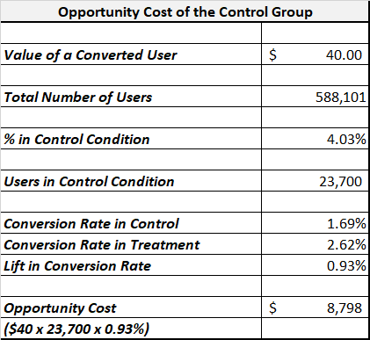
DIGITAL MARKETING
Digital Display Advertising Effectiveness
Opportunity Cost of the Control Group

Slide 29
DIGITAL MARKETING
Digital Display Advertising Effectiveness
What do we know?
Advertising seems to have an effect
Campaign ROI is positive
What do we not know?
Should the effect of advertising depend on frequency of exposures?
Could spend and exposures be optimized?

Slide 30
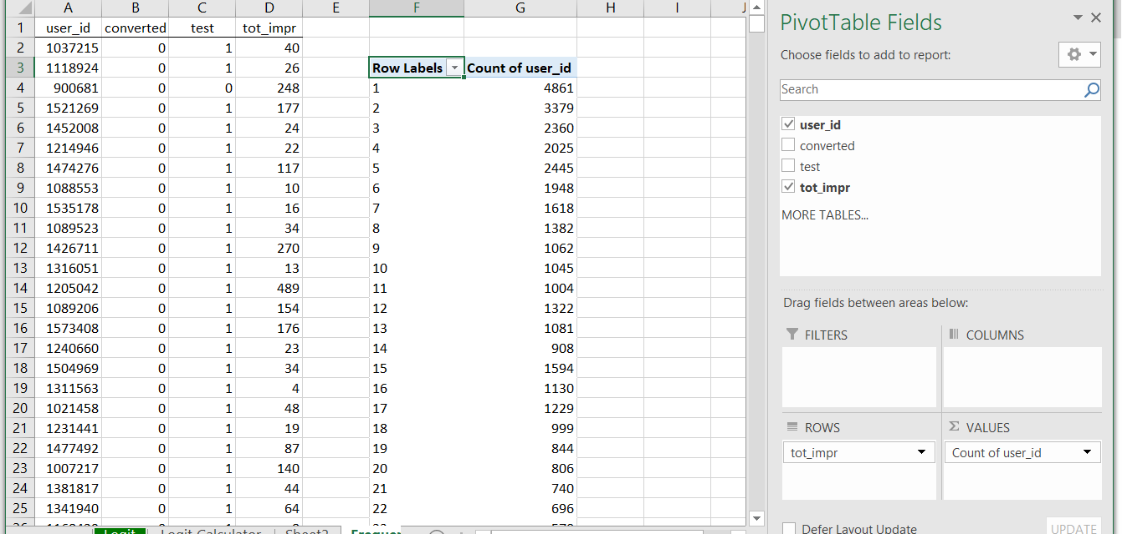
DIGITAL MARKETING
Digital Display Advertising Effectiveness
What Effect Does the Number of Impressions Have on Conversions?
In “Frequency Analysis” tab is a Pivot Table that shows how many users see 1 ad, 2 ads and so on
4,861 users are exposed to 1 ad
3,379 users are exposed to 2 ads

Slide 31
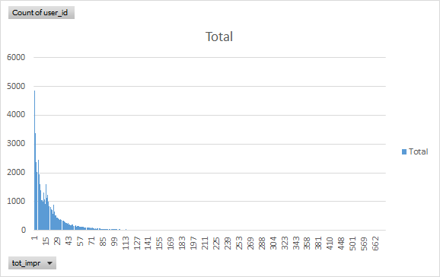
DIGITAL MARKETING
Digital Display Advertising Effectiveness
Very few users are exposed to more than 100 ads

Slide 32
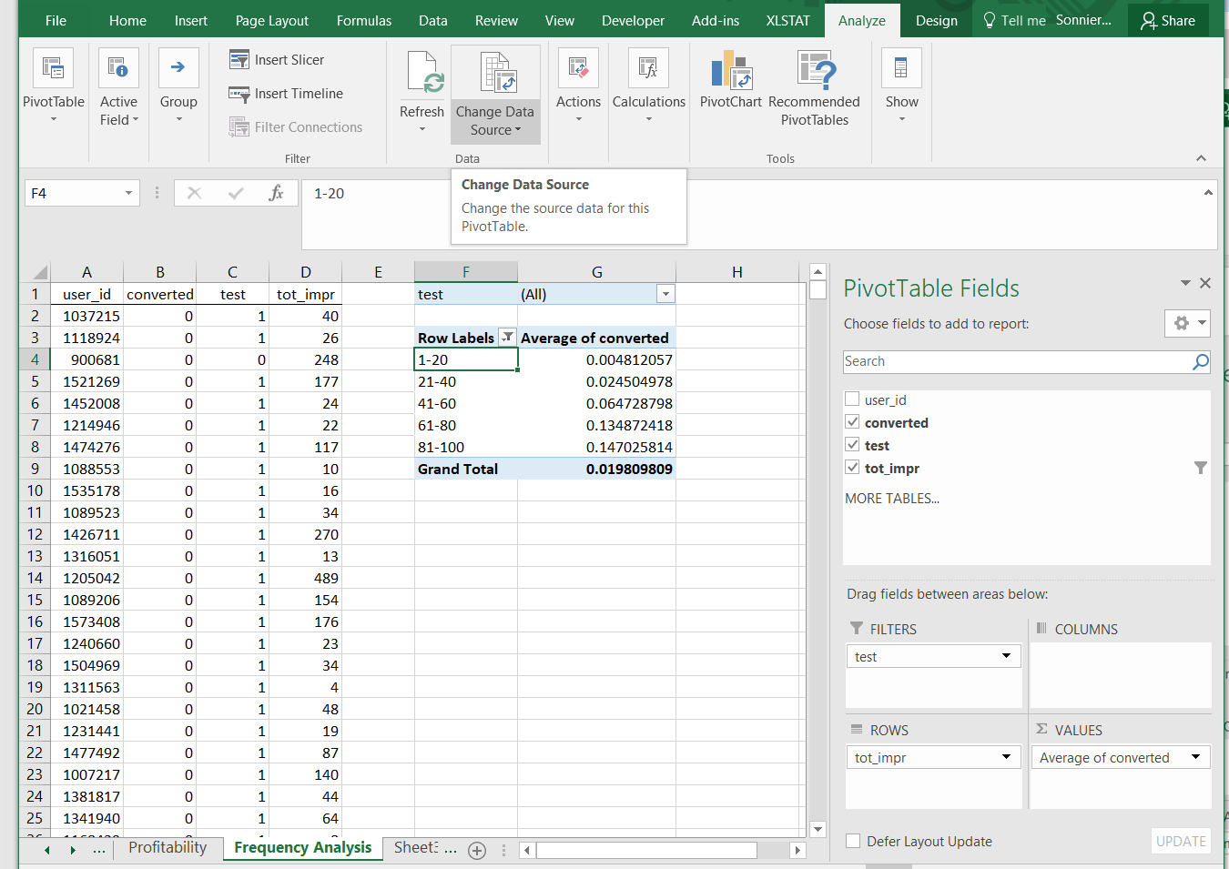
DIGITAL MARKETING
Digital Display Advertising Effectiveness
Group Analysis Tab
Filter by Test to See Treatment vs. Control Groups

Slide 33
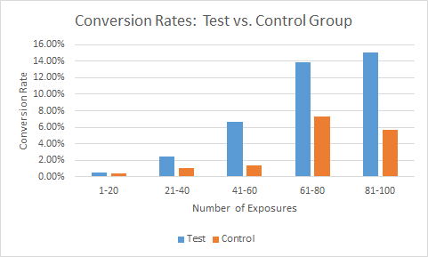
DIGITAL MARKETING
Digital Display Advertising Effectiveness
What Do We Learn From This Graph?
In the Test Group, advertising effectiveness increases then plateaus
When the Control Group sees more ads they become more responsive!
What is this effect? (it also seems to flatten out…)

Slide 34
DIGITAL MARKETING
Digital Display Advertising Effectiveness
What Do We Learn From This Graph?
Even among Control group conversion increases with number of exposures
But this CANNOT be due to advertising (unless Smokey the Bear is hawking designer handbags!)
People online MORE have a HIGHER propensity to buy and hence are MORE LIKELY to be targeted to be served an ad
These people live in equal proportions in the Treatment and Control groups because of random assignment
Since we have the control group we can control for this effect
But what about the plateau…consider the logarithm

Slide 35
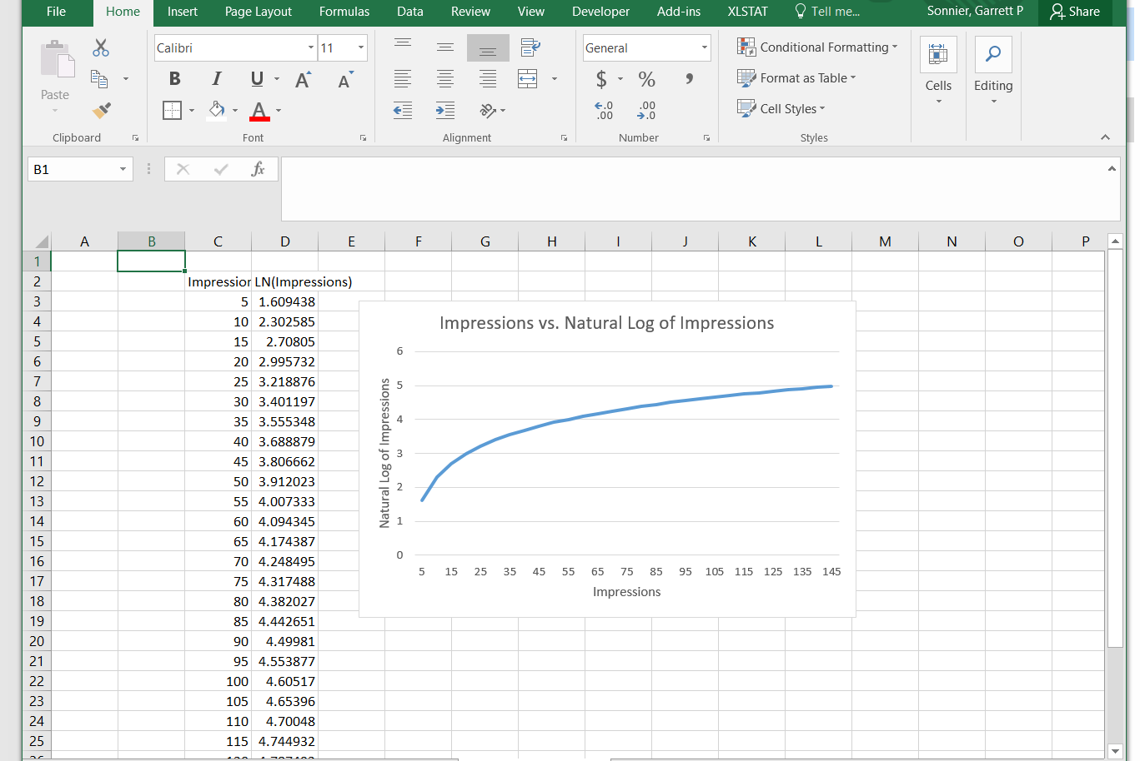
DIGITAL MARKETING
Digital Display Advertising Effectiveness
Logarithms! They are not just for elasticities!
Impressions vs. LN(Impressions)

Slide 36
DIGITAL MARKETING
Digital Display Advertising Effectiveness
Let’s go back to logistic regression
The propensity effect refers to the fact that people online more are better targets and likely to see more ads
Use LN(Imp) to control for the propensity effect
Multiply LN(Imp) by Test to compute the interaction effect between the # of impressions and being in the Treatment Group
This captures the incremental effect of advertising after controlling for the propensity effect

Slide 37
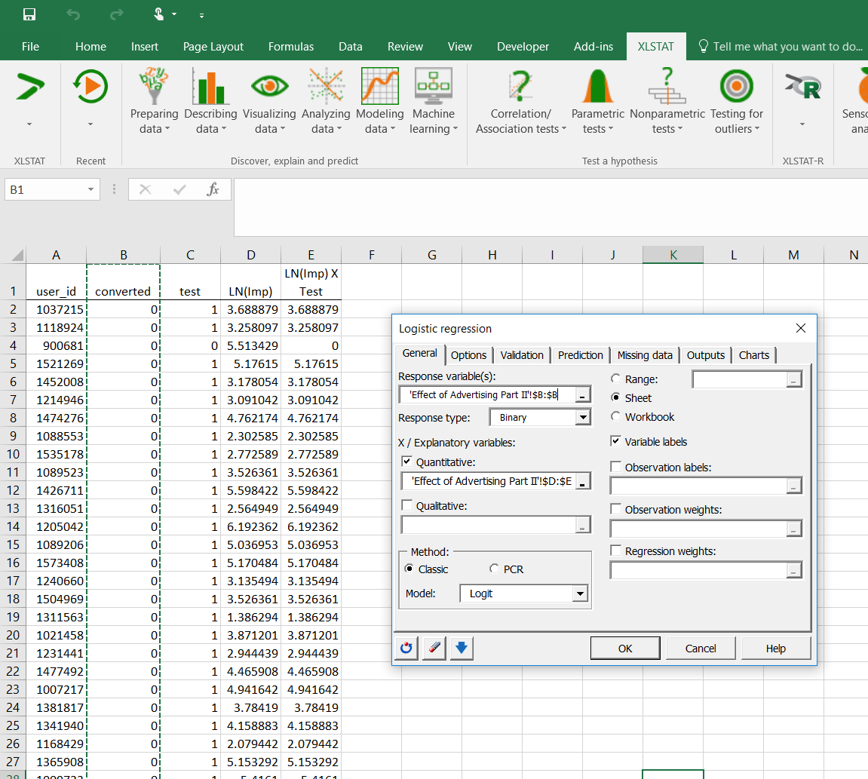
DIGITAL MARKETING
Digital Display Advertising Effectiveness
Let’s go back to logistic regression
Conversion is the response variable
LN(Impressions) is used to control for the propensity effect
The interaction of LN(Impressions) x Test estimates the effect of advertising

Slide 38
DIGITAL MARKETING
Digital Display Advertising Effectiveness
Let’s go back to logistic regression
We find a positive propensity effect---the more impressions you see the more likely you are to buy, whether you are in the test or the control group!
We find a positive effect of advertising---after controlling for propensity the interaction of the log of impressions and the treatment group is positive

Slide 39
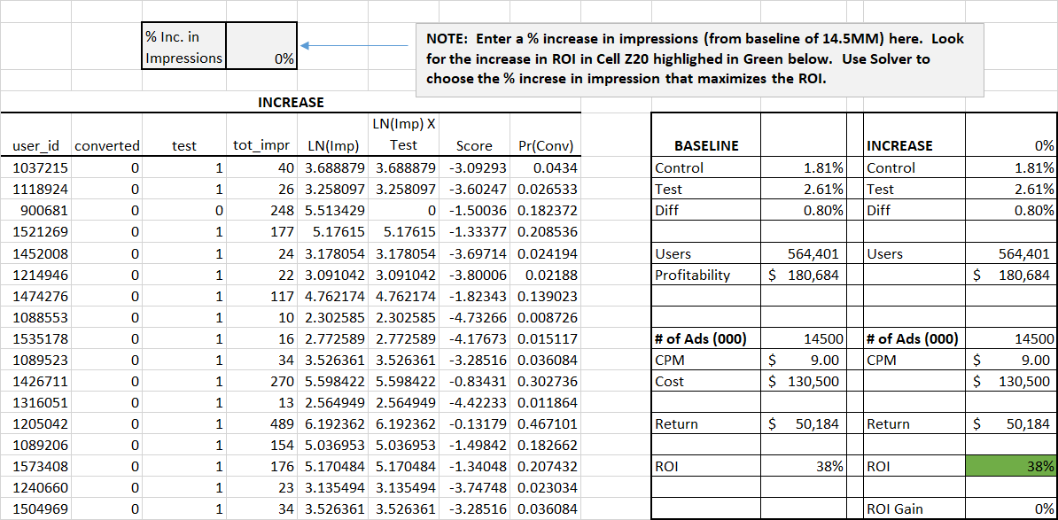
DIGITAL MARKETING
Digital Display Advertising Effectiveness
Is the company getting the most they can out of ad spend?

Slide 40
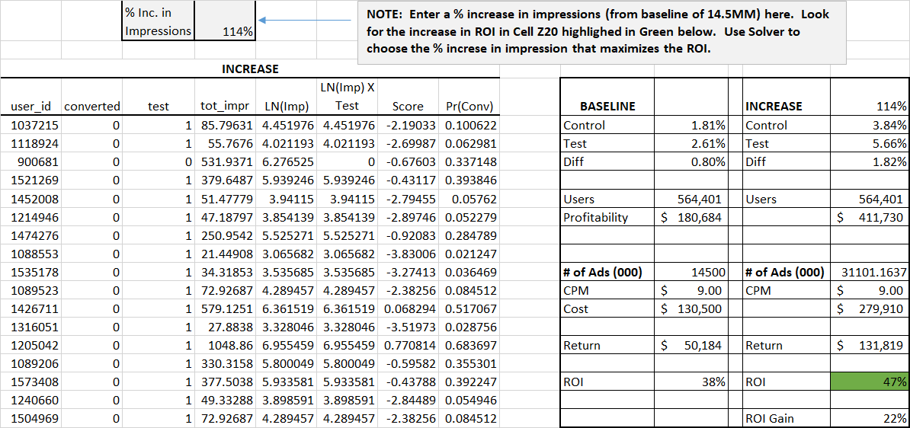
DIGITAL MARKETING
Digital Display Advertising Effectiveness
Company could more than double ad spend to generate a 22% improvement in ROI

Slide 41
DIGITAL DISPLAY AD EFFECTIVENESS
KEY CONCEPTS FROM TODAY
Trends in digital marketing
Threats to the validity of response models
Field experiments
Digital field experiments

